Slide 1




Electric
Disturbance

Slide 2






Al-Sayed Abdul Latif
Abdelmegeid Mamdouh
Mostafa Sayed
Team Members
Mohamed Farag
Philobater Magdy

Slide 3

The Content of Presentation
Overview of problem
KPI
Aim
Dashboard
Data Cleaning

Slide 4


Description of the Problem:
Electricity outages have become critical due to rising energy demands and more frequent climate-related disruptions. Although outage data has been collected since 2002, data quality and integrity inconsistencies continue to limit accurate analysis and effective decision-making.

Slide 5

Aim

Slide 6
Project Team Assumptions:
Comprehensive event coverage: We assumed the dataset fully captured all significant power outage events from 2002 to 2023 without any deletion data, ensuring our analysis encompassed all potential disruptions.
Broad “events" category: We calculated several events (3950 events), which were categorized into various categories representing the most common categories for power outages in different states.
Temporal trend consistency: We took the 2023 year as a reference for editing all years from 2002 to 2022.

Slide 7
Project Team Assumptions:
Most affected region (WECC): Based on standardized data collection, we assumed the WECC region was genuinely the most impacted, ensuring fair regional comparisons and an accurate reflection of geographic impact.
Consistent event categorization: We assumed that the classification of outage causes remained consistent over time, ensuring that any changes in the number of events for each category reflected external factors rather than shifts in reporting standards.
Outage frequency and duration correlation: We assumed that most event natural disaster is the main reason correlation between outage frequency and duration, exploring the possibility that more frequent outages might lead to longer downtimes due to resource strain or other systemic factors.

Slide 8

Data Cleaning

Slide 9
Data cleaning steps
Data Cleaning and Transformation (2002-2010)
Filter Rows: Filtered rows in the date column to focus on relevant records.
Time Formatting: Standardized time formatting by replacing variations like "p.m." to "PM," "a.m." to "AM," "noon" to "PM," and "Midnight" to specific times (e.g., 05:00:00 AM).
Null Replacements: Replaced missing, "NA," or "Unknown" values with nulls in the "Restoration Time" column.
Column Merging: Merged "Time" and "Date" columns for both the event and restoration times to create unified datetime columns.
Type Conversion: Changed column types to datetime for date and time fields, ensuring consistency for analysis.
Custom Duration Calculation: Added a custom column to calculate the duration between the event start time and the restoration time.

Slide 10
Text Cleaning: Trimmed text in columns such as "NERC Region," "Area," and "Type of Disturbance" to remove unnecessary spaces and characters.
Data Splitting: Split columns by delimiters (spaces or commas) in the restoration time fields when needed.
Column Renaming: Renamed columns to more descriptive names such as "Date & Time Event Began" and "Date Time of Restoration."
Data Cleaning and Transformation (2011-2014)
Replace unknown values and ongoing dates with null
Update "Date of Restoration" as follows:
Change "18/3/2001" to "18/3/2011".
Change "29/4/2014" to "30/4/2014".
Change "27/8/2077" to "27/8/2011".
Data Cleaning and Transformation (2015-2022)
Replace unknown values and ongoing dates with null

Slide 11
Data Cleaning and Transformation year 2023
Remove First Row: Deleted the first row to access the actual dataset.
Promote Headers: Set the first row as the column headers.
Adjust Data Types: Changed the "Date Event Began" column to date format and other relevant columns to appropriate types (date, time, integer).
Remove Unused Columns: Removed the "Alert Criteria" column.
Merge Date and Time: Combined the "Date Event Began" and "Time Event Began" into a single datetime column.
Handle Restoration Date and Time: Created new "Date of Restoration" and "Time of Restoration" columns, setting them to null if "Unknown," then merged them into a datetime column.
Rename Columns: Renamed the new columns (e.g., "Date of Restoration" and "Event Month").
Insert Month Name: Added a new column to display the month name based on "Date Time Event Began.“
Calculate Downtime Duration: Created a new column to calculate the time difference between "Date Time Event Began" and "Date Time of Restoration," then set the column type to duration.

Slide 12
Demand loss column:
Replace (N\A, all, UNK, Unknown, none) to null
Remove words like (approx., Est, less than, peak)
Using Peak value for demand loss
Getting average demand loss when there is range of values like (8000-10000) so demand loss will estimate 9000
Customer Effected column:
Replace values such as (N\A, all, UNK, Unknown, none, PG&E) with null.
Remove terms like (approx., Est, less than, greater than, over, peak).
Assume zero for utilities and industrial values.
Treat any missing data as null.
For ranges of people affected (e.g., 8000-10000), estimate the average (e.g., 9000).

Slide 13
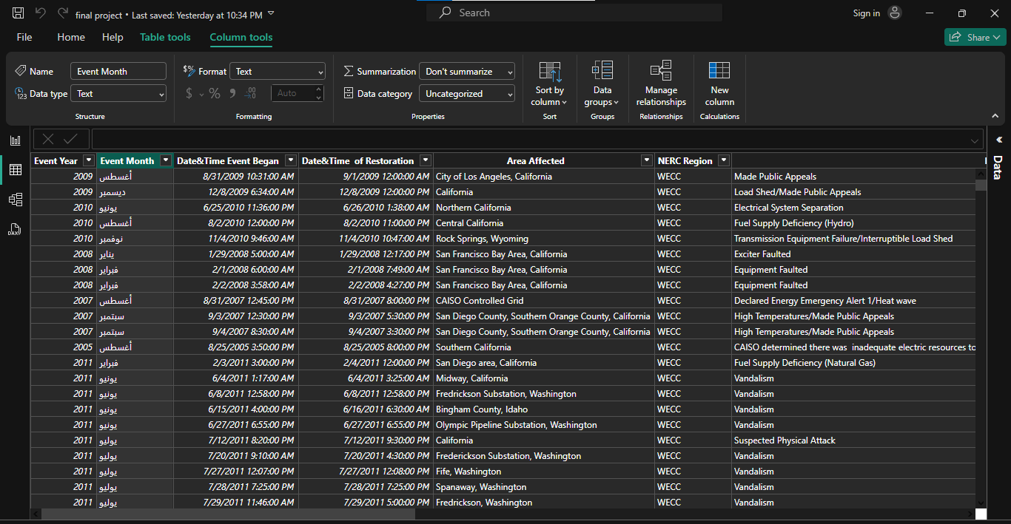

Slide 14
KPI

Slide 15
Analysis of Power Outages Over Time
KPI: Year-over-year (YoY) increase or decrease in power outages.
Impact of Outages on Communities
KPI: Average number of people affected per outage.
KPI: Total demand loss (in MW) during outages.
Event Type Significance
KPI: Outages by event type.
KPI: Percentage of outages with downtime exceeding a threshold.
Note: normalize event type to take into consideration the outliers that may skew data.
Downtime and Duration Analysis
KPI: Average downtime per outage.
KPI: Calculate the mode for downtime and normalize the event type into groups.
The most impact on states
1. KPI: most and fewer states have been affected by an outage of power.

Slide 16

Dashboard

Slide 17
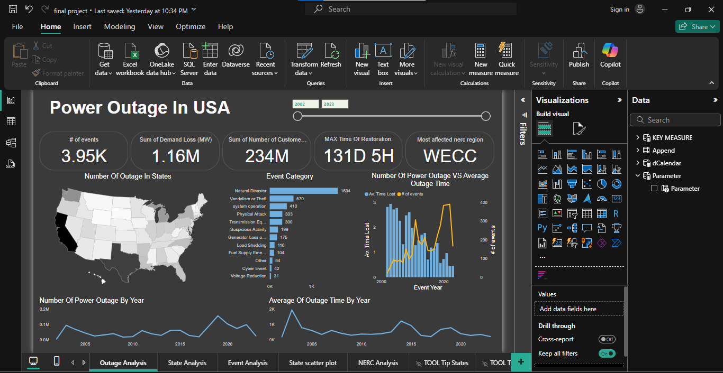
Power outage in USA
1_
Total of events: 3950
Total of Demond loss:
1.16 M
2_
Total of customer effect: 234 M
3_
4_
Max time of restoration: 131 Days 5 Hours
5_
Most affected NERC Region: WECC

Slide 18
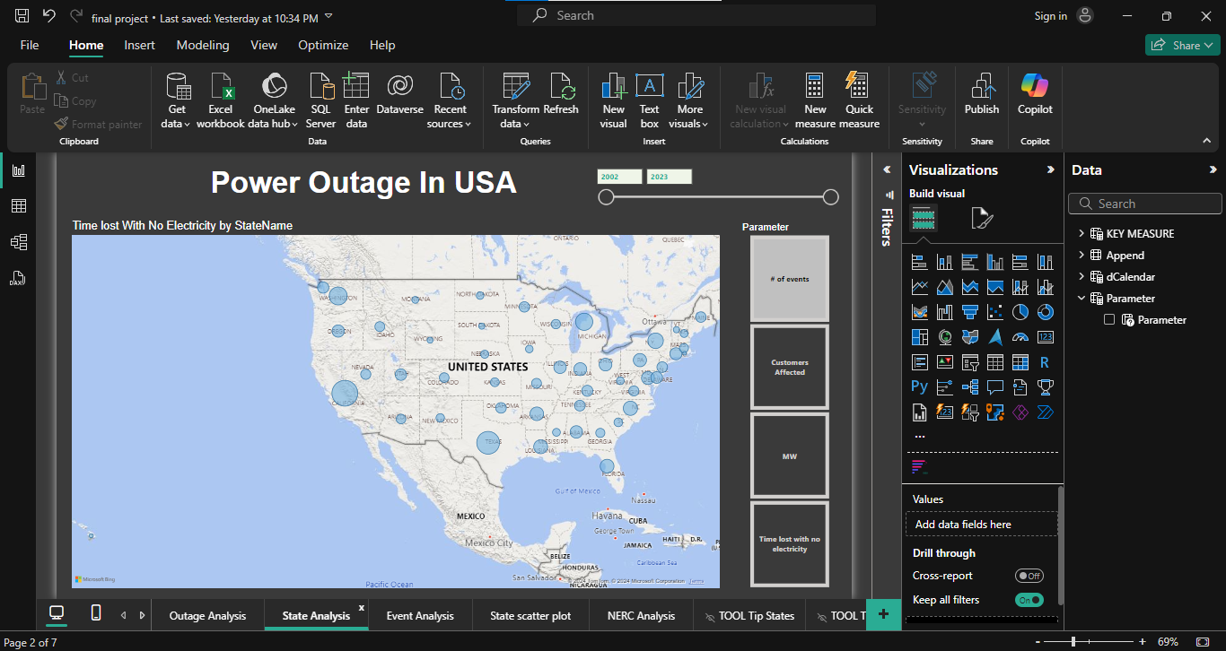
State analysis :
The most state affected:
According to events and customers affected
1_
California
The less state affected:
2_
Montana

Slide 19
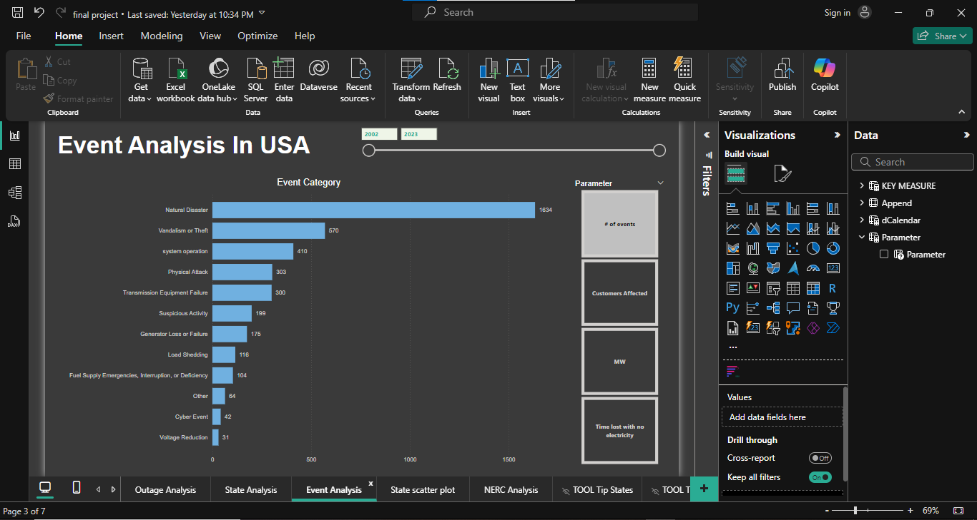
Event analysis :
1_
Natural Disaster
2_
Vandalism or Theft
System Operation
3_
Physical attack
4_

Slide 20
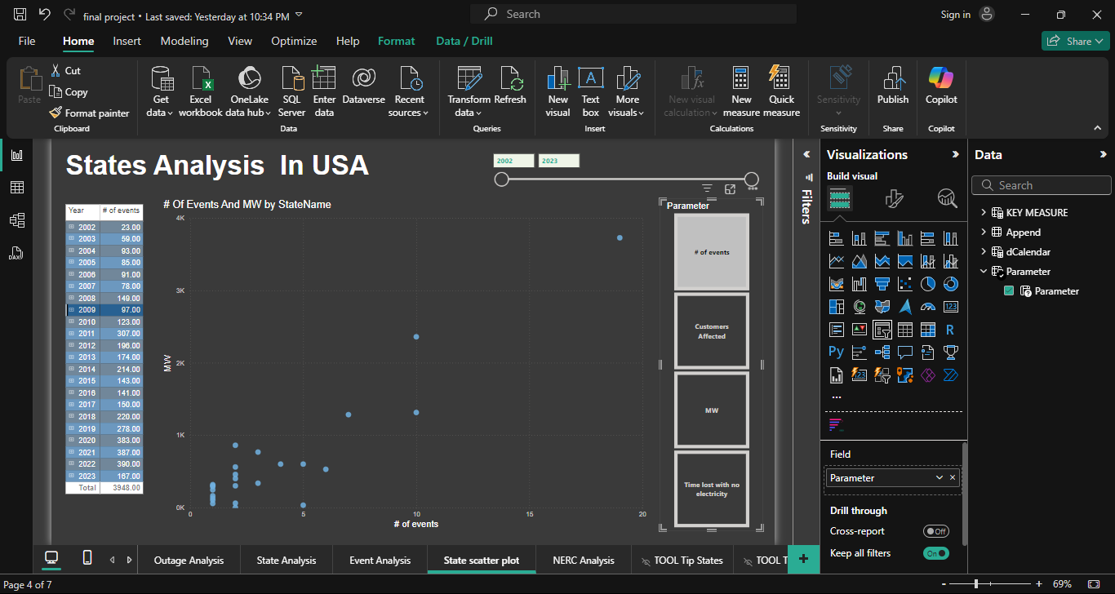
State analysis :

Slide 21
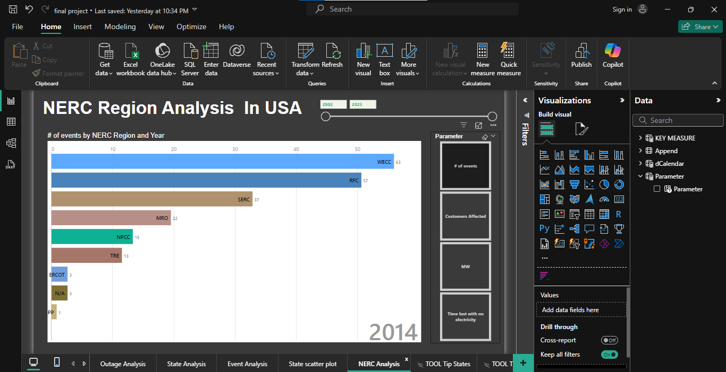
NERC analysis :

Slide 22

Reference
Report
https://docs.google.com/document/d/1QaNsu0w_4AfM2n18fgSZGupUrCWmynXQ/edit?usp=sharing&ouid=112915212538405498813&rtpof=true&sd=true
Project steps
https://docs.google.com/document/d/1Fsd9OBLtMGkIikRa0U4-m8uBc32_fhXc/edit?usp=sharing&ouid=112915212538405498813&rtpof=true&sd=true
Dashboard
https://app.powerbi.com/groups/me/reports/9905c8ec-3a5d-4786-8dae-0e3c0fbb045f?experience=power-bi

Slide 23
Recommendation
Enhance Cybersecurity
1_
Strengthen infrastructure Resilience:
2_
Preventive Maintenance and Monitoring
3_
Implement Smart Grid Technology
4_
5_
Establish Contingency Plans and Rapid Response Teams

Slide 24

DEPI Graduation Project

